Slide 1
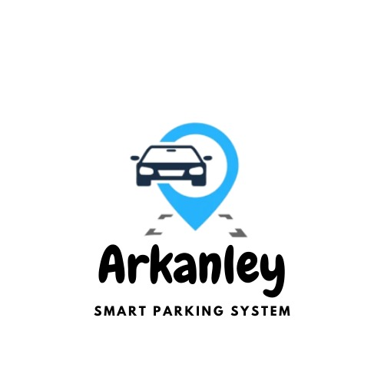


Supervised by:
Dr. Esraa Elhariri
Dr. Asmaa Sweidan

Slide 2
Arkanley Team
01
Mohamed Sayed Mohalhal
ms4002@fayoum.edu.eg
02
Abdelrhman Abouelenan Gaber
aa5184@fayoum.edu.eg
03
Mohamed Sayed Mohamed Yaaqob
ms4001@fayoum.edy.eg
04
Abdelrhman Rabie Ashry
ar2243@fayoum.edu.eg
05
Ahmed Khaled Mohamed
Ak1751@fayoum.edu.eg
06
Omar Ehab Ahmed Mahmoud
Oe1168@fayoum.edu.eg
07
Ahmed Mansour Abdelghani
am5427@fayoum.edu.eg

Slide 3
Introduction
Problem Definition
Objective and Motivations
Literature review
The Proposed System

Slide 4
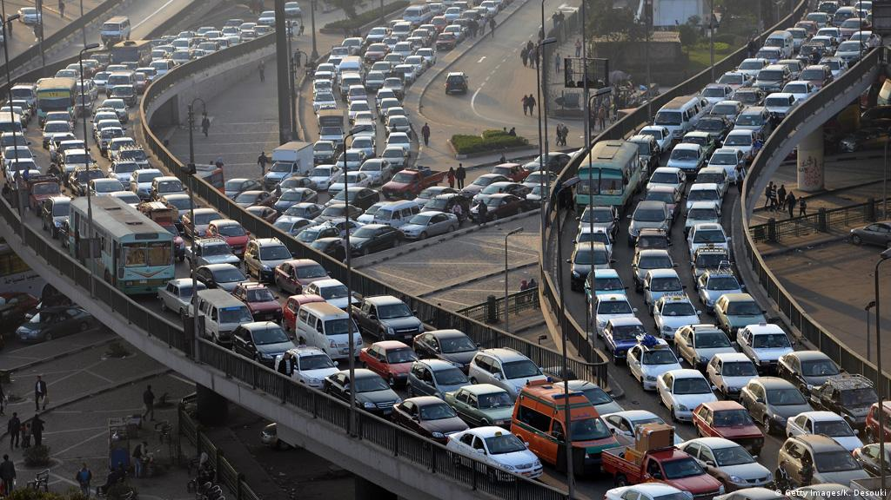
Introduction
Nowadays, a wide range of smart systems are delivered as a result of the growth of mobile networks, sensor networks, and the ubiquity of computing and cloud computing. Smart systems for everyday demands such as parking, transporting and working have been sustainedly developed to achieve higher system performance and efficiency .
Smart car parking in Egypt aims to address the problem of limited and inefficient parking in urban areas of the country. We use a combination of sensors, cameras, and mobile applications to provide information.

Slide 5

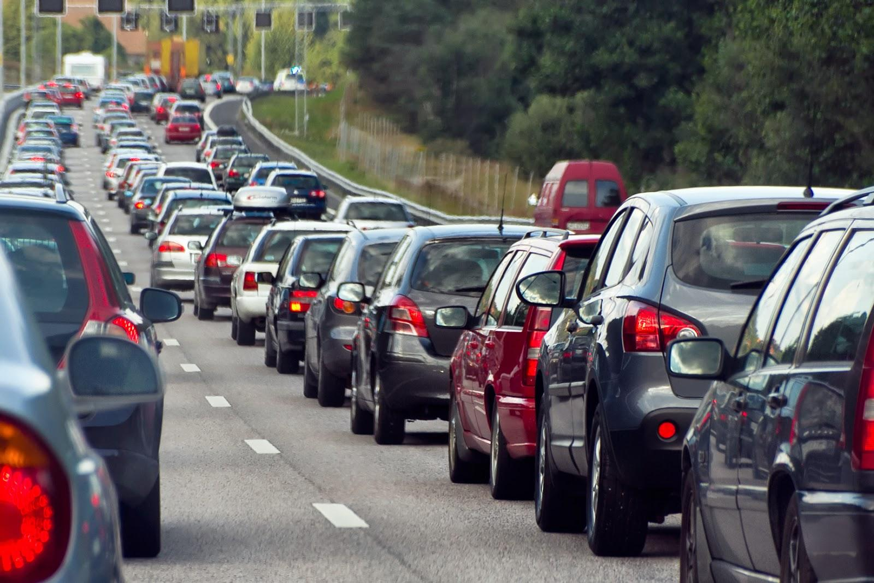
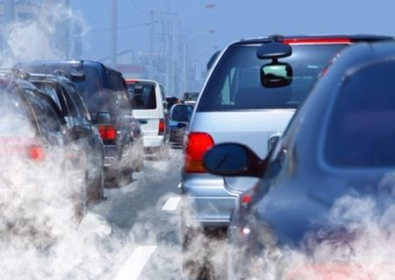
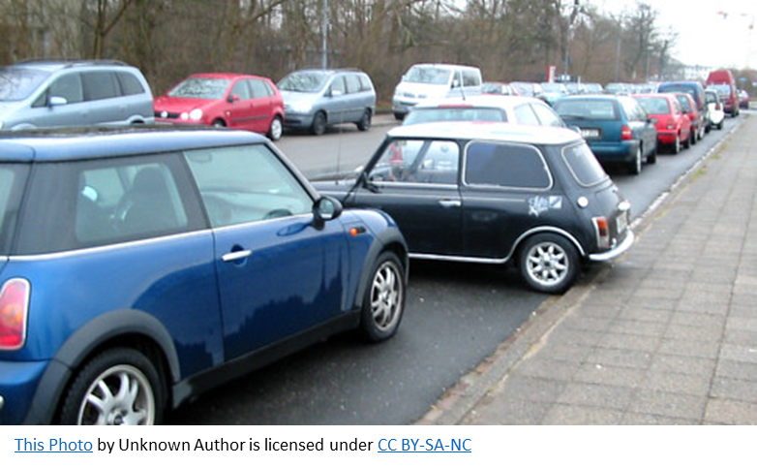

Problems
Searching for and getting a parking space has always been a concern.
It causes
Wasting time.
Traffic congestion.
Environmental Pollution.
The presence of cars on the street sometimes leads to theft or other cars colliding with them.
The number of vehicles moving on the road is increasing day by day, while the amount of free space remains the same.

Slide 6
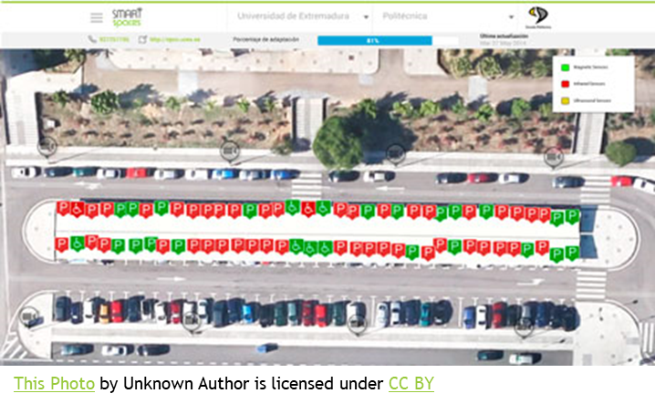
Objectives
Automation development for smart parking
Saving time and effort.
Reducing traffic congestion.
Reducing environmental pollution and fuel consumption costs.
Reducing the problems of parking in illegal places.
Providing special places for people with special needs and supporting them.

Slide 7

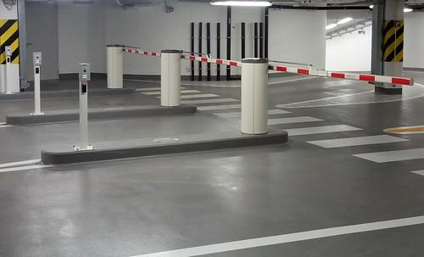


Motivation
Additional economic and investment income.
Making full use of the parking spaces for the owners of the parking, by converting it to fully automated.
Because of the technological developments that occurred in society, we made us think to make reserving a parking space easier and faster.
Reducing car thefts through the security system located inside Automated Smart Parking.
More automation and less manual work result in lower management costs and less resource depletion.

Slide 8
RELATED WORK
Rahman Atiqur et al. IN (2021)
Used Embedded System : Raspberry pi 4 ,ultrasonic sensors, LED display, RFID module,Speaker, GSM module as well as parking servo motor.
M.V.S.S.BABU et al.In(2021)
Used wep and Arduino Uno
Alam Nasyrah Muharram et al.IN(2021)
Used mobile application & embeded system(RFID reader RFID tag Jumper cable
Battery holder & IOT & Firebase and Wireshark
LCD 16x2 Lithium-ion battery

Slide 9
RELATED WORK
G. Manjula et al. In(2022)
Used machine learning & wep & embedded system & IOT
Yash Agarwal et al. In(2021)
Used embedded system & mobile application & IOT
H Canli et al. In(2021)
Used mobile application & machine learning & deep learning
M. Saheer Jhugroo et al. In(2021)
Used embedded system & mobile application & IOT & cloud

Slide 10
RELATED WORK
Joel Charles et al. In(2022)
Used embedded system & mobile application & IOT & Firebase
Aamir Anwar et al. In(2021)
Used embedded system & mobile application & 5g

Slide 11
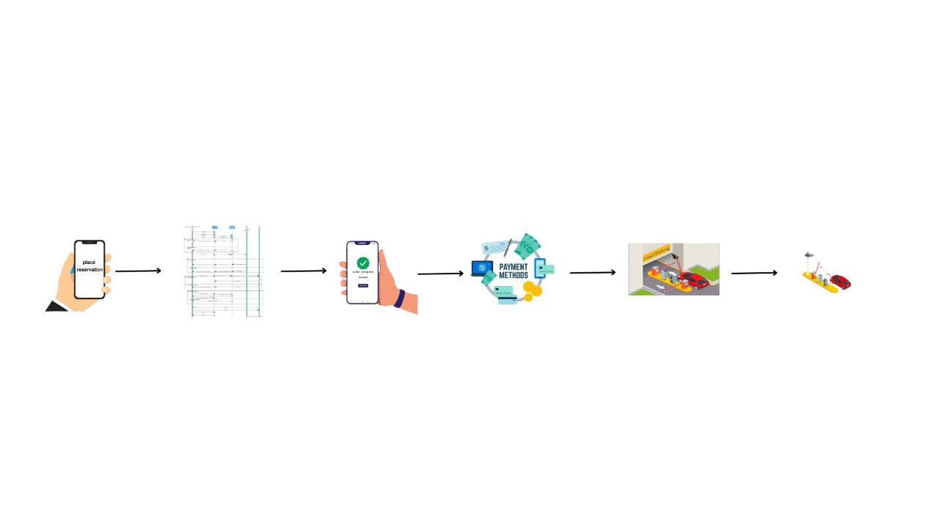
Frame work
Figure: 1

Slide 12
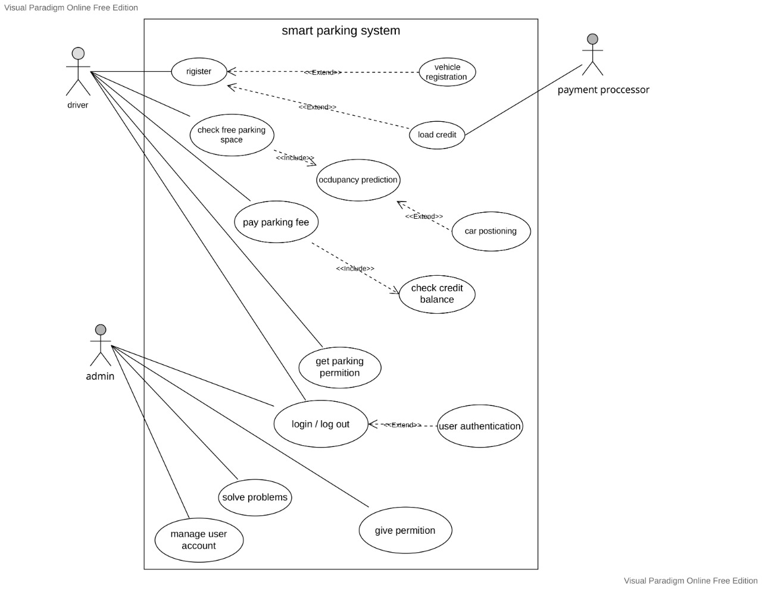
Use case diagram
Figure: 2

Slide 13
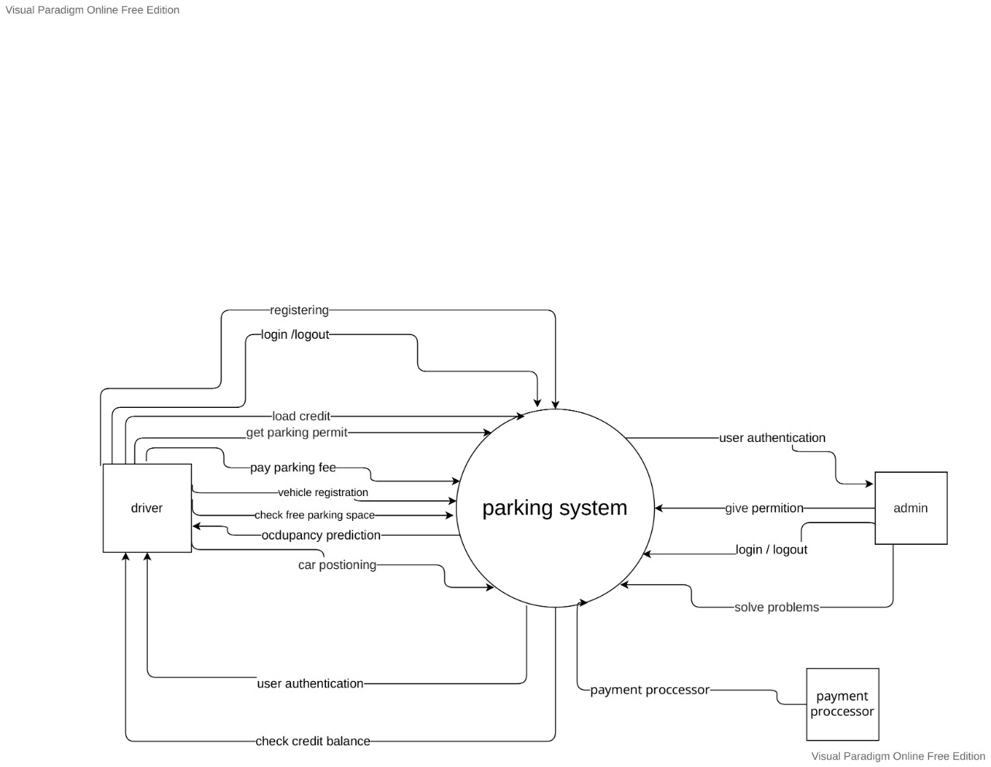
Context diagram
Replace with your own text
Figure: 3

Slide 14
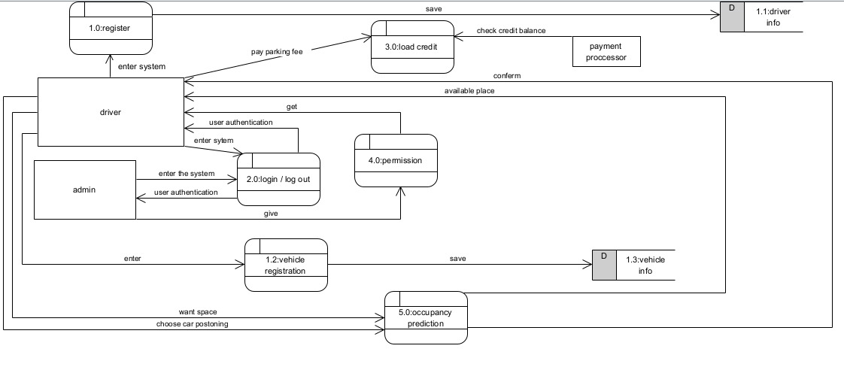
Data flow diagram
Figure: 4

Slide 15
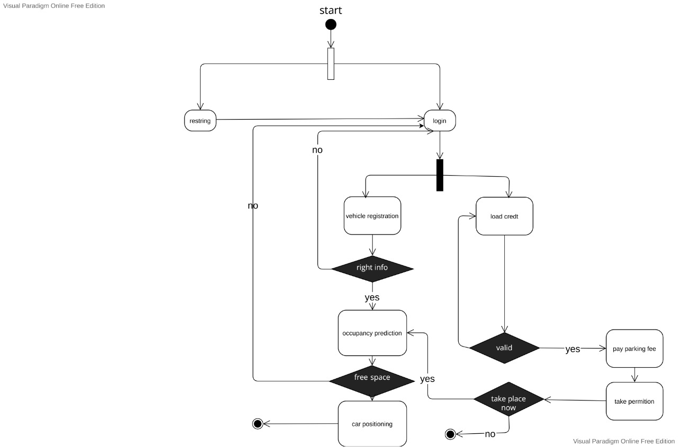
Activity diagram
Figure: 5

Slide 16
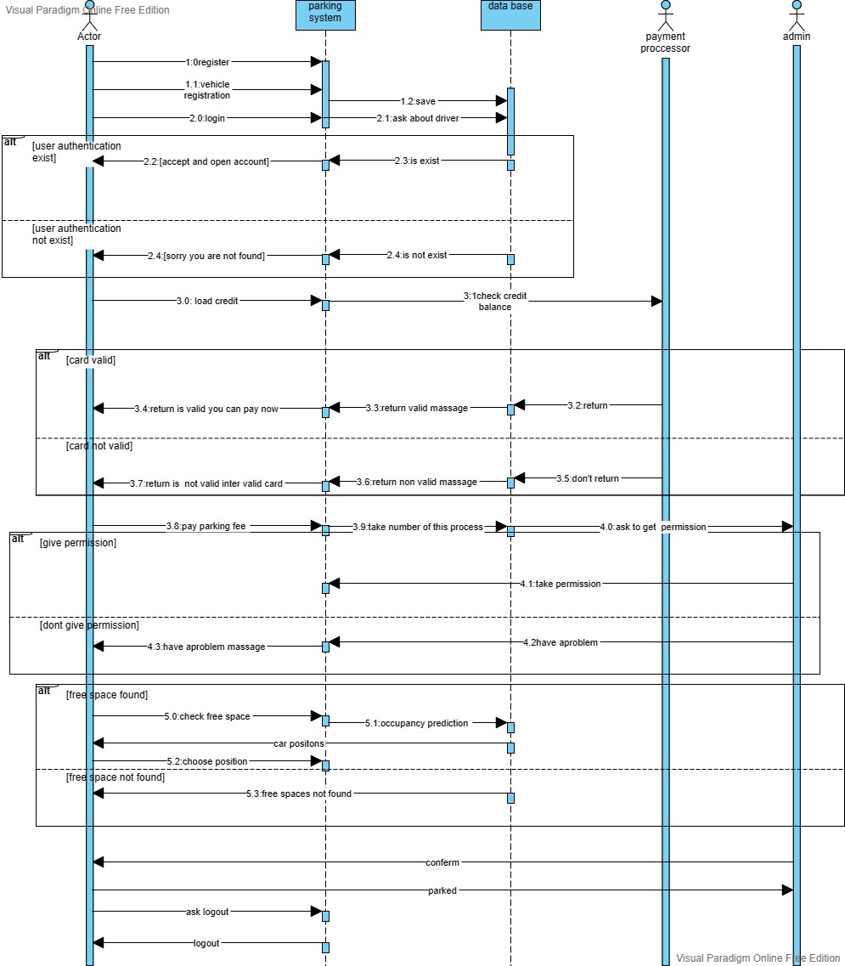
Sequence diagram
Figure: 6

Slide 17
THANK YOU

